Slide 1
5 : Introduction to bootstrap

Slide 2
Introduction
Bootstrap is a front-end framework (Front end frameworks are used for decorating the look and feel of the view)
Bootstrap helps in building mobile responsive websites quickly and easily
Bootstrap is totally free for anyone to use
First developed by Twitter known as Twitter Bootstrap
It is now used for developing simple web applications to complex ones focusing the front end of the web sites

Slide 3
Introduction
Bootstrap has a number of jQuery plugins that can provide additional functionality
  Eg: carousels, buttons, tooltips, typography, buttons, tables, navigation, modals and
It includes HTML and CSS based design templates for, forms, buttons, tables, navigation, modals, image carousels and many other components, as well as optional JavaScript plugins
It saves effort, cost of development and time
A basic understanding of HTML and CSS to create sites that are responsive, mobile-first, and compatible with all modern browsers
Preconditions
  Basic knowledge of HTML and CSS

Slide 4
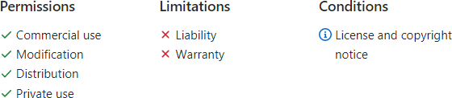
License of Bootstrap
Bootstrap is under MIT License
See the project repository for more details of the license https://github.com/twbs/bootstrap/blob/mai/LICENSE
Source: https://github.com/twbs/bootstrap/blob/mai/LICENSE

Slide 5
Setup Bootstrap into the development environment
It is essential to integrated the bootstrap framework with the web pages you develop
Integration can be done in two different ways
  You can download the bootstrap framework and integrate locally with the HTML files
  Directly refer the CDN (Content Delivery Network) links online

Slide 6
Download and install in different environments
Bootstrap allows source code version download or precompiled development ready versions or third party package managers to install bootstrap
  Compiled CSS and JS
  Source code
  Package managers
    Examples: Npm, RubyGems, yarn, composer and nuget

Slide 7
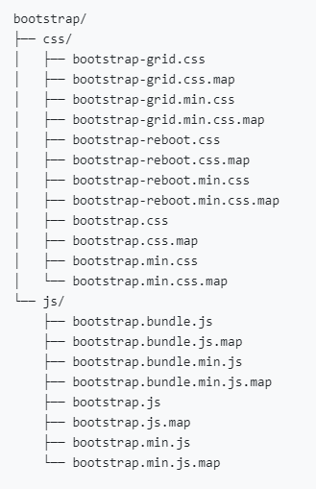
Using compiled CSS and JS
This version includes
  Compiled and minified CSS versions
  Compiled and minified JavaScript plugins
Source files, bootstrap documentation content and supportive materials are excluded
Can be directly used in a local web development setup

Slide 8
Example integration
Link external style sheet into the web page
<Link rel=“stylesheet” href=“local path to css file”>
Link javascript file into web page
<script src=“local path to js file”>

Slide 9
Source files download
Source files can be customized in case you need to change the default definitions
If you download the source file version, it is your responsibility to compile it using a suitable compiler (Syntactically awesome style sheets compiler)
  Eg : Libsass , Ruby Sass
Once you compile the source files you can use it for development purposes

Slide 10
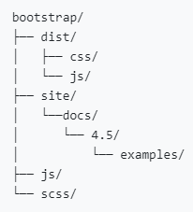
Bootstrap bundle contents
“dist” directory contains the compiled version of js and css
“scss” and “js” directories include the source files of js and css
“site” directory includes the files related to documentation and example codes of Bootstrap usage
any other included file provides support for packages, license information

Slide 11
Bootstrap CDN (Content Delivery Network)
Integrate the bootstrap files through urls (Do not need to locally maintain the files)
No need of downloading files and using in your projects locally
Both css and JavaScript content can be linked through CDN
Use conventional “link” and “script” tags to include css and javascript files
Include CDN versions of jQuery and Popper.js before integrating the compiled JavaScript

Slide 12
Example CSS integration through BootstrapCDN
<link rel="stylesheet“ href="https://stackpath.bootstrapcdn.com/bootst rap/4.4.1/css/bootstrap.min.css" integrity="sha384Vkoo8x4CGsO3+Hhxv8T/Q5PaXt kKtu6ug5TOeNV6gBiFeWPGFN9MuhOf23Q9Ifjh" crossorigin="anonymous">
Source: https://getbootstrap.com/docs/4.4/getting-started/download/

Slide 13
Example JavaScript integration through BootstrapCDN
<script src="https://stackpath.bootstrapcdn.com/bootstr ap/4.4.1/js/bootstrap.min.js" integrity="sha384wfSDF2E50Y2D1uUdj0O3uMBJn juUD4Ih7YwaYd1iqfktj0Uod8GCExl3Og8ifwB6" crossorigin="anonymous">
</script>
Source: https://getbootstrap.com/docs/4.4/getting-started/download/

Slide 14
CDN versions of jQuery and Popper.js
<script src="https://code.jquery.com/jquery-3.4.1.slim.min.js" integrity="sha384- J6qa4849blE2+poT4WnyKhv5vZF5SrPo0iEjwBvKU7imGFAV0wwj1yYfo RSJoZ+n" crossorigin="anonymous"></script>
<script src="https://cdn.jsdelivr.net/npm/popper.js@1.16.0/dist/umd/poppe r.min.js" integrity="sha384- Q6E9RHvbIyZFJoft+2mJbHaEWldlvI9IOYy5n3zV9zzTtmI3UksdQRVvox MfooAo" crossorigin="anonymous"></script>
Source: https://getbootstrap.com/docs/4.4/getting-started/download/

Slide 15
Using Package Managers to install Bootstrap
Package Manager | Command to install Bootstrap
npm | npm install bootstrap
yarn | yarn add bootstrap
RubyGems | gem ‘bootstrap’, ‘~> 4.4.1’ (4.4.1 is the version you want to install)
Composer | composer require twbs/bootstrap:4.4.1
NuGet | Install-Package bootstrap

Slide 16
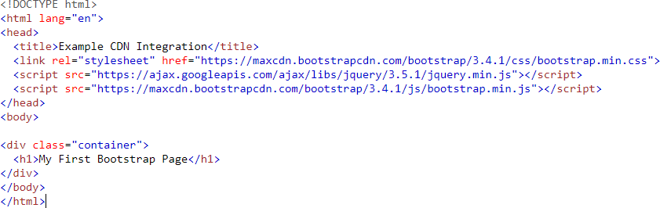
Example [all in one place]

Slide 17
Advantages of Bootstrap
Easy to use: Needs basic knowledge of HTML and CSS to start using Bootstrap
Responsive features: Allows to adjust the interface to phones, tablets, and desktops
Mobile-first: Bootstrap 3, mobile-first styles are part of the core framework
Compatible with browsers: Supports frequently used common browsers like Chrome, Firefox, Internet Explorer, Edge, Safari, and Opera

Slide 18
Advantage of using the Bootstrap CDN:
Bootstrap CDN will not load each site access
It will be loaded from cache without recurrently downloading the files from the source online
Caching files lead to faster loading time
jQuery (Important)
Bootstrap depends on jQuery for JavaScript plugins
  (Eg: modals, tooltips, etc)
  jQuery is not necessary only if the css part is used

